Slide 1
INFORMAL LETTER
An informal letter is a letter you would write to a friend, a family member or an acquaintance.

Slide 2
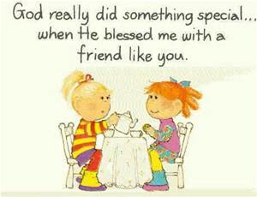
TO A FRIEND

Slide 3
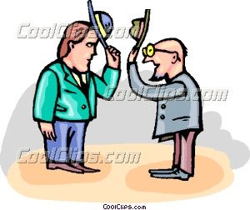
AN ACQUIANTANCE

Slide 4

OR A FAMILY MEMBER

Slide 5
The classic informal letter has five parts as follows:
1st…. Address Block
Your address, also known as the “return address”, comes first, to the left –top of the page along with the date.
Letter to a friend

Slide 6
notice
Where the address starts
Where and how it ends
Leave a line to write the date-dmy

Slide 7
2. Opening Salutation
This is the opening greeting; typically "Dear John". Left-justify this block. More terms- Hi, Hello, Dearest, Respected
(starts on the left, leave a line after the date)

Slide 8
The third part- body block
This is your actual letter content (introduction + main parts + final paragraphs). It can be anywhere from a few paragraphs in length up to multiple pages. In the exam the length of the letter will be defined in the task (usually somewhere between 120 and 180 words). The body paragraphs should be left justified. Some examples:-

Slide 9
Example of a letter’s main part-body

Slide 10
4.Closing Salutation
This is where you say goodbye. Typically, closing salutations for informal letters include such phrases as: "Yours truly,", "Your friend,", "All the best,", Take care,“ "See you soon,", "Don't be a stranger,", etc.
Left-justify the closing salutation.

Slide 11
The 5th part is the signature or how to sign-off
The sign-off depends on the salutation. If addressed to 'Dear (friends name)'; sign-off such as 'With love', 'Best wishes' or 'Love from' are usual.
Cheerful greetings to all,
Hugs,
Wishing you the best,
Write soon,
Your friend,
Yours in friendship,
Kind thoughts,
Take care.

Slide 12
Signature Block
Since it is an informal letter to someone who knows you reasonably well, just sign your first name.
Also left-justify this block.

Slide 13
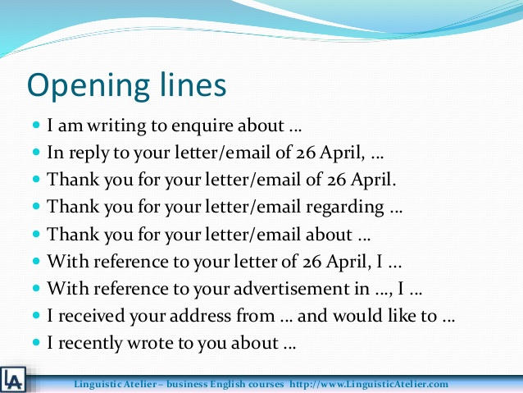

Slide 14
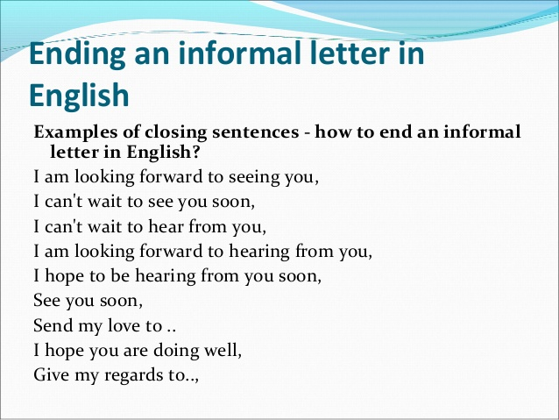

Slide 15
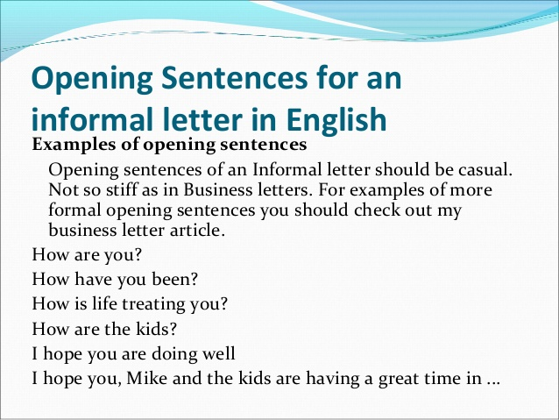

Slide 16
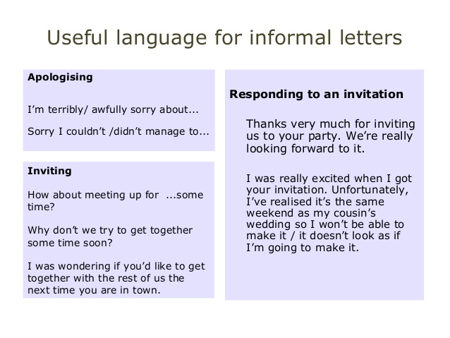

Slide 17
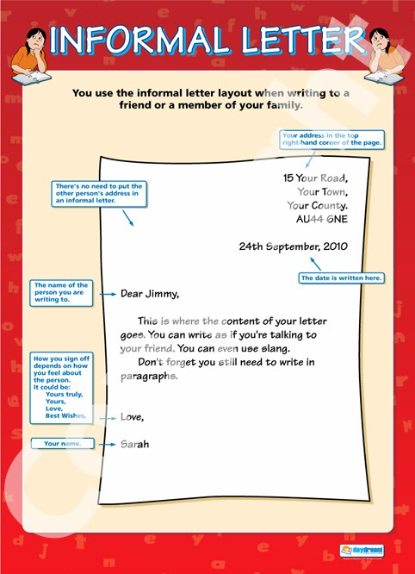
point out the mistakes

Slide 18
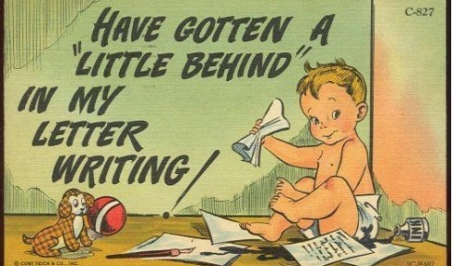
DID WE OR DID WE NOT?....UNDERSTAND!
NOW TODAY ITSELF I’LL WRITE ONE!

